Slide 1
Programming for problem solving
Presented by,
Devipriya M
Assistant professor
SRM IST Trichy

Slide 2
String
In C language, a sequence of characters, digits and symbols enclosed within double quotation marks is called a string.
The string is always declared as character array and its elements are stored in contiguous memory locations.
To manipulate text such as words and sentences, normally strings are used. Every string is terminated with ‘\0’ (NULL) character.
The NULL character is a byte with all bits at logic zero. Hence, its decimal value is zero.
char name[]={‘I’,‘N’,‘D’,‘I’,‘A’,‘\0’}; Each character of the string occupies 1 byte of memory. The last character is always ‘\0’.

Slide 3

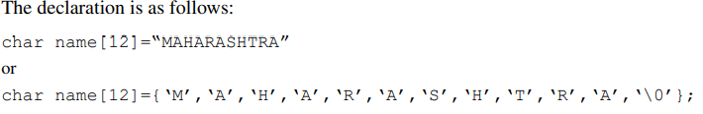

The characters of a string are stored in contiguous (neighboring) memory locations.

Slide 4
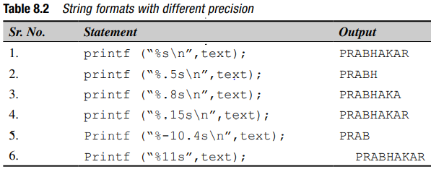
Strings in printf
char text[15]=“PRABHAKAR”;

Slide 5
String functions
C compiler supports a large number of string handling library functions.
Table 8.3 provides the list of many frequently used functions and their description.
The header file string.h is to be initialized whenever standard library function is used.
In other words, the string handling functions are given in string.h.

Slide 6
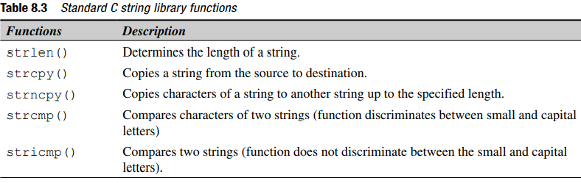

Slide 7
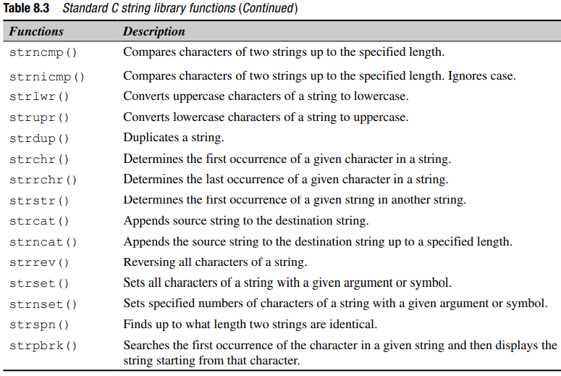

Slide 8
String functions
strlen() function
This function counts the number of characters in a given string. The syntax of the function is strlen (char *s);
strcat function
The strcat() function concatenates the destination string and the source string, and the result is stored in the destination string.
char *strcat(char *dest, const char *src)

Slide 9
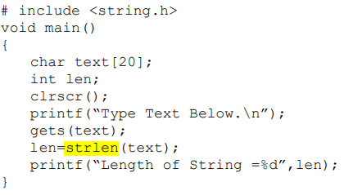


Slide 10
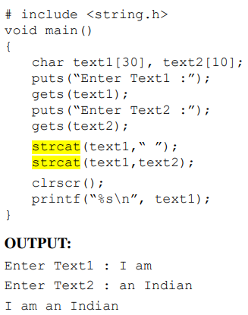

Slide 11
strcmp
The strcmp function compares two strings identified by the arguments and has a value 0 if they are equal.
If they are not, it has the numeric difference between the first nonmatching characters in the strings.
strcmp(“their”, “there”);
will return a negative value which is the numeric difference between ASCII “i” and ASCII “r” is negative.
will return a positive value which is the numeric difference between ASCII is positive.
That is, “i” minus “r” in ASCII code is –9. If the value is negative, string1 is alphabetically above string2.

Slide 12
Strcmp
#include <stdio.h>
#include <string.h>
int main() {
char str1[] = "their", str2[] = "there", str3[] = "abcd";
int result;
// comparing strings str1 and str2
result = strcmp(str1, str2);
printf("strcmp(str1, str2) = %d\n", result);
// comparing strings str1 and str3
result = strcmp(str1, str3);
printf("strcmp(str1, str3) = %d\n", result);
return 0;
}
Output:
-1
1

Slide 13
strstr
strstr() function
This function finds the second string in the first string. It returns the pointer location from where the second string starts in the first string.
In case the first occurrence in the string is not observed, the function returns a NULL character.
strstr (char *string1,char *sring2);

Slide 14
strstr
#include <string.h>
#include <stdio.h>
int main()
{
// Take any two strings
char s1[] = "Fun with STL";
char s2[] = "STL";
char* p;
// Find first occurrence of s2 in s1
p = strstr(s1, s2);
if (p) {
strcpy(p, "Strings");
printf("%s", s1);
} else
printf("String not found\n");
return 0;
}
Output:
Fun with Strings

Slide 15

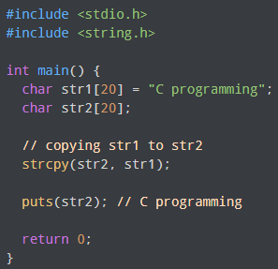
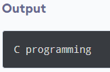
strcpy
Syntax

Slide 16
Strrev
Syntax
# include <string.h>
void main()
{
char text[15];
puts(“Enter String”);
gets(text);
puts(“Reverse String”);
puts(strrev(text));
}
OUTPUT:
Enter String
ABCDEFGHI
Reverse String
IHGFEDCBA

Slide 17
Strtok
Function strtok (Fig. 8.26) is used to break a string into a series of tokens.
A token is a sequenceof characters separated by delimiters (usually spaces or punctuation marks, but a delimiter can be any character).
For example, in a line of text, each word can be considered a token, and the spaces and punctuation separating the words can be considered delimiters.

Slide 18

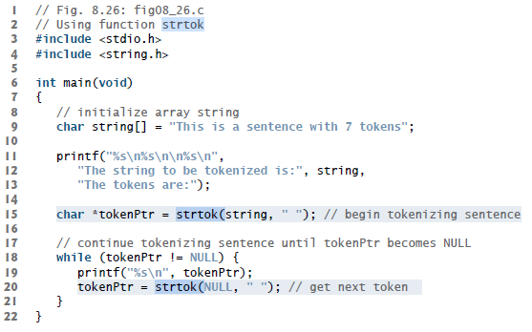

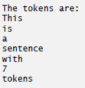
Strtok
Syntax
Output:

Slide 19
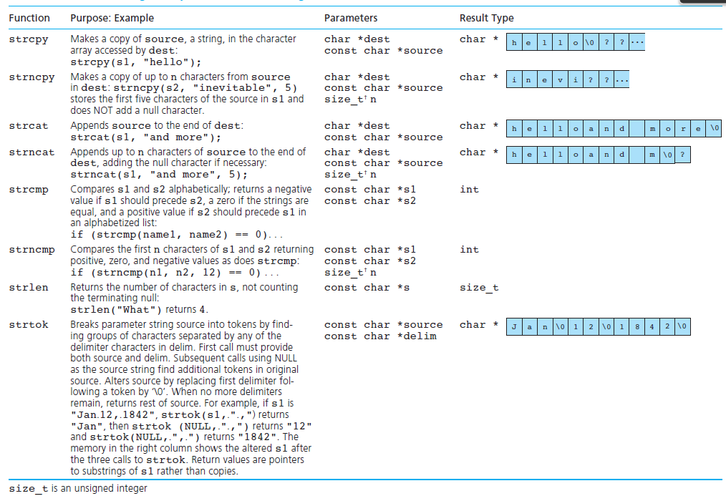

Slide 20
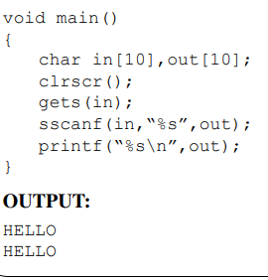
sscanf
The sscanf() function allows to read characters from a character array and writes them to another array.

Slide 21
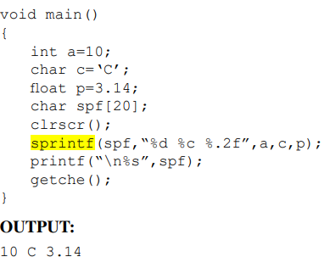
sprintf
The sprintf() function is similar to the prinf() function except a small difference between them.
The printf() function sends the output to the screen whereas the sprintf() function writes the values of any data type to an array of characters

Slide 22
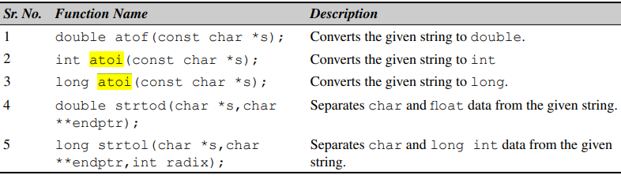
String conversion functions

Slide 23
atoi
# include <stdlib.h>
#include<stdio.h>
void main()
{
int i; long i1;
i=atoi("99.11");
i1=atoi("99999999");
printf("%d\n%ld",i,i1);
}
Output:
99
99999999

Slide 24
putchar
#include <stdio.h>
int main () {
char ch;
for(ch = 'A' ; ch <= 'Z' ; ch++) {
putchar(ch);
}
return(0);
}
Output:
ABCDEFGHIJKLMNOPQRSTUVWXYZ

Slide 25
puts
#include<stdio.h>
int main()
{
//string initialisation
char Mystr[] = "C and C++";
puts(Mystr); //writing the string to stdout
return 0;
}
Output:
C and C++

